Slide 1
Introduction to Systems Security
(January 14, 2010)
© Abdou Illia – Spring 2010

Slide 2
Learning Objectives
Discuss main security threats
Discuss types of systems’ attacks
Discuss types of defense systems

Slide 3
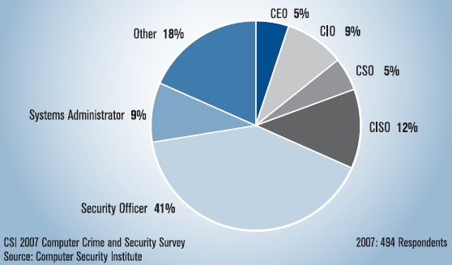
2009 Computer Crime and Security Survey (2009 CSI Security Report)
Survey conducted by the Computer Security Institute (http://www.gocsi.com).
Copy of Survey report on course web site
Based on replies from 494 U.S. Computer Security Professionals.

Slide 4
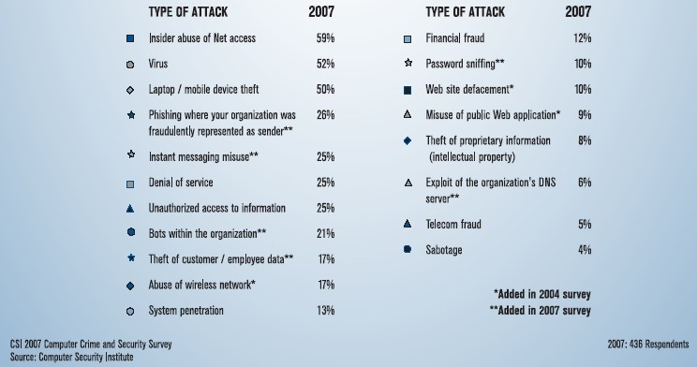
2009 CSI Report: Types of attacks or Misuse in last 12 months

Slide 5
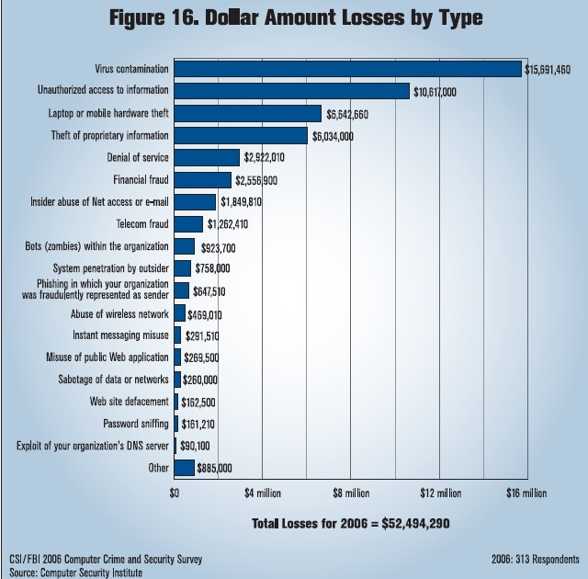
2008 CSI Survey vs 2009 CSI
2007: $66,930,950 reported by 194 respondents

Slide 6
Attack Trends
Growing Incident Frequency until 2001
  Incidents reported to the Computer Emergency Response Team/Coordination Center
1998 | 1999 | 2000 | 2001
3,474 | 9,859 | 21,756 | 52,658
Growing Malevolence since 2000
  Most early attacks were not malicious
  Malicious attacks are the norm today

Slide 7
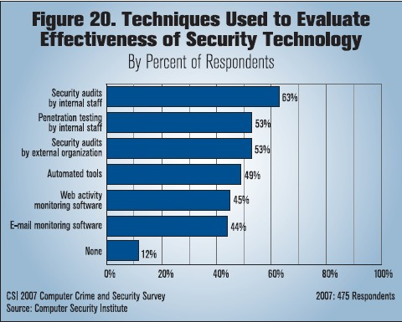
2009 CSI Survey: Security monitoring

Slide 8
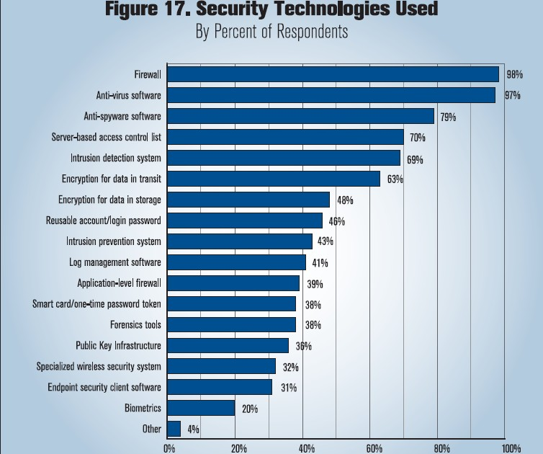
2009 CSI Survey: Defense Technology

Slide 9
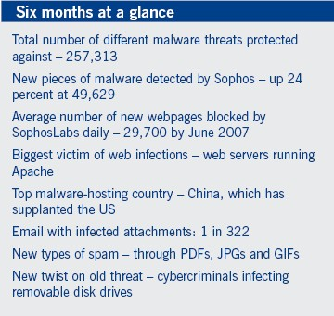
2009 Sophos Security Threat Report
Report focused on Sophos’ security software
General discovery
*
* Infected USB drives take advantage of computers that have auto-run enabled, which allow the automated execution of code contained on the flash drive.

Slide 10
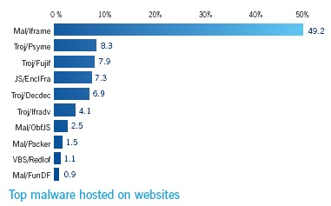
2009 Sophos Security Threat Report
Malware* hosted on websites
* Malicious software

Slide 11
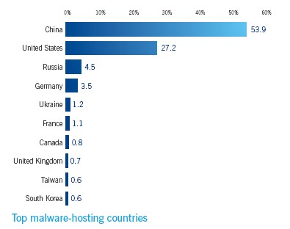
2009 Sophos Security Threat Report
Malware hosting countries

Slide 12
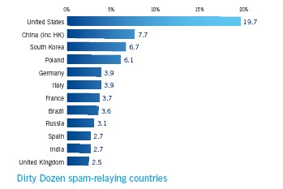
2009 Sophos Security Threat Report
Spam-relaying countries
Climbing the list year after year

Slide 13
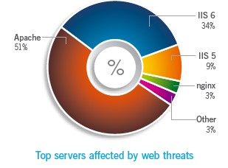
2009 Sophos Security Threat Report
Web server’s software affected
Web server software
Apache
IIS
SunONE
Operating System
Computer hardware
RAM chip
HD
Processor
Web server computer
As of March 2007 Apache served 58% of all web servers
Apache available for Microsoft Windows, Novell NetWare and Unix-like OS

Slide 14
Other Empirical Attack Data
Riptech (acquired by Symantec)
  Analyzed 5.5 billion firewall log entries in 300 firms in 5-month period
  Detected 128,678 attacks
    i.e. 1,000 attacks per firm / year
  Attacks were:
    Code Red and Nimda virus/worm (69%)
    Other non-target attacks (18%)
    Target attacks (13%)

Slide 15
Other Empirical Attack Data
SecurityFocus
  Data from 10,000 firms in 2001
  Attack Targets
    31 million Windows-specific attacks
    22 million UNIX/LINUX attacks
    7 million Cisco IOS attacks
    All operating systems are attacked!

Slide 16
Summary Questions (Part 1)
What does malware refer to?
Systems running Microsoft operating systems are more likely to be attacked than others. T F
With Windows OS, you can use IIS or another web server software like Apache. T F
What web server software is most affected by web threats today?
What types of email-attached file could/could not hide a malware?
Could USB drives be used as means for infecting a system with malware? How?

Slide 17
Systems attackers
Attackers
Elite Hackers
Script Kiddies
Virus writers & releasers
Corporate employees
Elite Hackers
  Hacking: intentional access without authorization or in excess of authorization
  Characterized by technical expertise and dogged persistence, not just a bag of tools
    Use attack scripts to automate actions, but this is not the essence of what they do
  Could hack to steal info, to do damage, or just to prove their status
Cyber vandals
Cyber terrorists

Slide 18
Systems attackers
Elite Hackers (cont.)
  Black hat hackers break in for their own purposes
  White hat hackers can mean multiple things
    Strictest: Hack only by invitation as part of vulnerability testing
    Some hack without permission but report vulnerabilities (not for pay)
  Ethical hackers
    Hack without invitation but have a “code of ethics”
      e.g. “Do no damage or limited damage”
      e.g.“Do no harm, but delete log files, destroy security settings”

Slide 19
Systems attackers
Attackers
Elite Hackers
Script Kiddies
Virus writers & releasers
Corporate employees
Script Kiddies
  “Kids” that use pre-written attack scripts (kiddie scripts)
  Called “lamers” by elite hackers
  Their large number makes them dangerous
  Noise of kiddie script attacks masks more sophisticated attacks
Cyber vandals
Cyber terrorists

Slide 20
Systems attackers
Attackers
Elite Hackers
Script Kiddies
Virus writers & releasers
Corporate employees
Virus Writers and Releasers
  Virus writers versus virus releasers
  Writing virus code is not a crime
  Only releasing viruses is punishable
Cyber vandals
Cyber terrorists

Slide 21
Systems attackers
Attackers
Elite Hackers
Script Kiddies
Virus writers & releasers
Corporate employees
Cyber vandals
  Use networks to harm companies’ IT infrastructure
  Could shut down servers, slowdown eBusiness systems
Cyber warriors
  Massive attacks* by governments on a country’s IT infrastructure
Cyber terrorists
  Massive attacks* by nongovernmental groups on a country’s IT infrastructure
Hackivists
  Hacking for political motivation
Cyber vandals
Cyber terrorists
* Multi-pronged attacks: release virus, active hacking, attacking Internet routers, etc.

Slide 22
Summary Questions (Part 2)
What is meant by white hat hacker?
What is the difference between script kiddies and elite hackers?
Is releasing a virus a crime in the U.S.?
What is the difference between cyber war and cyber terrorism?

Slide 23
Attacks preps: examining email headers
Received: from hotmail.com (bay103-f21.bay103.hotmail.com [65.54.174.31])
by barracuda1.eiu.edu (Spam Firewall) with ESMTP id B10BA1F52DC
for <aillia@eiu.edu>; Wed, 8 Feb 2006 18:14:59 -0600 (CST)
Received: from mail pickup service by hotmail.com with Microsoft SMTPSVC;
Wed, 8 Feb 2006 16:14:58 -0800
Message-ID: <BAY103-F2195A2F82610991D56FEC0B1030@phx.gbl>
Received: from 65.54.174.200 by by103fd.bay103.hotmail.msn.com with HTTP;
Thu, 09 Feb 2006 00:14:58 GMT
X-Originating-IP: [192.30.202.14]
X-Originating-Email: [macolas@hotmail.com]
X-Sender: macolas@hotmail.com
In-Reply-To: <10E30E5174081747AF9452F4411465410C5BB560@excma01.cmamdm.enterprise.corp>
X-PH: V4.4@ux1
From: <macolas@hotmail.com>
To: aillia@eiu.edu
X-ASG-Orig-Subj: RE: FW: Same cell#
Subject: RE: FW: Same cell#
Date: Thu, 09 Feb 2006 00:14:58 +0000
Mime-Version: 1.0
Content-Type: text/plain; format=flowed
X-OriginalArrivalTime: 09 Feb 2006 00:14:58.0614 (UTC) FILETIME=[DCA31D60:01C62D0D]
X-Virus-Scanned: by Barracuda Spam Firewall at eiu.edu
X-Barracuda-Spam-Score: 0.00
Source IP Address
IP Address Locator: http://www.geobytes.com/IpLocator.htm
Display email headers in Gmail, Yahoo!, Hotmail: http://aruljohn.com/info/howtofindipaddress/

Slide 24
Attacks preps: examining email headers
Sending computer’s domain name and IP Address. A proxy server is used to hide the sending computer’s real IP address for security reason.
Received: from Spyro364 (12-208-4-66.client.mchsi.com [12.208.4.66])
by fillmore.eiu.edu (Postfix) with ESMTP id AD8A739C18F4;
Fri, 29 Aug 2008 23:31:27 -0500 (CDT)
Return-Receipt-To: "Trevor Bartlett" <tjbartlett@eiu.edu>
From: "Trevor Bartlett" <tjbartlett@eiu.edu>
To: "Laura Books" <laura.books.l16v@statefarm.com>,
"Brad Burget" <brad_burgett@cat.com>,
"Jan Runion" <jan_runion@admworld.com>,
"Mandi Loverude" <mloverude@appliedsystems.com>,
"Joe Benney" <Joseph.Benney@metavante.com>,
"John Walczak" <john.walczak@salliemae.com>
Cc: "Vicki Hampton" <vahampton@eiu.edu>, "Abdou Illia" <aillia@eiu.edu>
Subject: AITP Networking With IT Professionals
Date: Fri, 29 Aug 2008 23:31:27 -0500
Message-ID: !&!AAAYAAAAAAAHlvebngHR1Ho0mBdl39GGiCgAAAEAAAAIhhC6mcc1ZGhpyF6F1EIaoBAAAAAA==@eiu.edu
MIME-Version: 1.0
Content-Type: multipart/alternative;
boundary="----=_NextPart_000_0000_01C90A2F.5CB9A220"
X-Mailer: Microsoft Office Outlook 12.0
Thread-Index: AckKWTTHhYKvGjoUQfSXzrjBGue7+g==
Content-Language: en-us
Could ping fillmore.eiu.edu to have DNS convert the EIU’s receiving server’s name (i.e. fillmore.eiu.edu) into the corresponding IP address of the server.
IP Address Locator: http://www.geobytes.com/IpLocator.htm
Display email headers in Gmail, Yahoo!, Hotmail: http://aruljohn.com/info/howtofindipaddress/

Slide 25
Attacks preps: examining email headers
Received: from barracuda.eiu.edu (barracuda1.eiu.edu [139.67.8.80])
by eureka.eiu.edu (Postfix) with ESMTP id D355235FF8D8
for <aillia@eiu.edu>; Fri, 29 Aug 2008 23:22:04 -0500 (CDT)
X-ASG-Debug-ID: 1220070124-092800670000-XywefX
X-Barracuda-URL: http://139.67.8.80:8000/cgi-bin/mark.cgi
Received: from ismtp1.eiu.edu (localhost [127.0.0.1])
by barracuda.eiu.edu (Spam Firewall) with ESMTP id 94B32111114D
for <aillia@eiu.edu>; Fri, 29 Aug 2008 23:22:04 -0500 (CDT)
Received: from ismtp1.eiu.edu (ismtp1.eiu.edu [139.67.9.21]) by barracuda.eiu.edu with ESMTP id OHAHGovHCxVIjPwe
X-IronPort-Anti-Spam-Filtered: true
X-IronPort-Anti-Spam-Result: vkAABNnuEjBwp4Wo2dsb2JhbACROoEPAQEBAQEBBwUIBxGedBUIA4Y5YwMIBHiDLw
Received: from exchange-zav1.bvdep.com ([193.194.158.22]) by ismtp1.eiu.edu with ESMTP; 29 Aug 2008 23:22 -0500
Received: from safaribo.bvdep.com ([172.28.32.40]) by exchange-zav1.bvdep.com with Microsoft SMTPSV(5.0.2195);
Sat, 30 Aug 2008 06:22:01 +0200
Received: from mail pickup service by safaribo.bvdep.com with Microsoft SMTPSVC;
Sat, 30 Aug 2008 00:22:01 -0400
From: <welcome@coursesmart.com>
To: <aillia@eiu.edu>
X-ASG-Orig-Subj: Welcome to CourseSmart
Subject: Welcome to CourseSmart
Date: Sat, 30 Aug 2008 00:22:01 -0400
Message-ID: <000001c90a57$f2e6bc10$28201cac@be.bvd>
MIME-Version: 1.0
Content-Type: text/plain;
193.194.158.22 is the IP address of the sender’s email server. That server delivered the email to ismtp1.eiu.edu
172.28.32.40 could be considered the source IP address. It’s actually the shown IP address of the first computer in the chain of devices involved in the sending. It’s more likely the IP address of a “pick up server”.
IP Address Locator: http://www.geobytes.com/IpLocator.htm
Display email headers in Gmail, Yahoo!, Hotmail: http://aruljohn.com/info/howtofindipaddress/

Slide 26
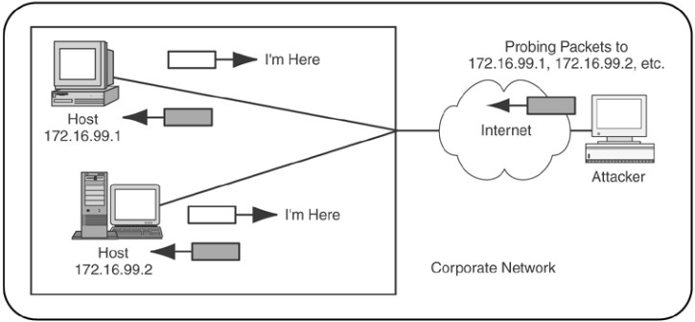
Attacks preps: looking for targets
Scanning (Probing)
  Ping messages (To know if a potential victim exist and is turned-on)
    Firewalls usually configured to prevent pinging by outsiders
  Supervisory messages (To know if victim available)
  Tracert, Traceroute (To know how to get to target)
http://www.netscantools.com/nstpro_netscanner.html

Slide 27
Attacks preps: identifying targets
Examining scanning result reveals
    IP addresses of potential victims
    What services victims are running. Different services have different weaknesses
    Host’s operating system, version number, etc.
Whois database at NetworkSolutions.com also used when ping scans fail
Social engineering
  Tricking employees into giving out info (passwords, keys, etc.)
Deciding the type of attacks to launch given available info

Slide 28
Framework for Attacks
Attacks
Physical Access
Attacks
--
Wiretapping
Server Hacking
Vandalism
Social Engineering
--
Opening Attachments
Password Theft
Information Theft
Dialog Attacks
--
Eavesdropping
Impersonation
Message Alteration
Penetration
Attacks
Malware
--
Viruses
Worms
Scanning
(Probing)
Denial of
Service
Break-in

Slide 29



Dialog attack: Eavesdropping
Intercepting confidential message being transmitted over the network
Dialog
Hello
Client PC
Bob
Server
Alice
Hello
Attacker (Eve) intercepts
and reads messages

Slide 30
Dialog attack: Message Alteration
Intercepting confidential messages and modifying their content
Dialog
Balance =
$1
Balance =
$1,000,000
Client PC
Bob
Server
Alice
Balance =
$1
Balance =
$1,000,000
Attacker (Eve) intercepts
and alters messages

Slide 31
Dialog attack: Impersonation
I’m Bob
Hi! Let’s talk.
Client PC
Bob
Attacker
(Eve)
Server
Alice

Slide 32
Encryption: Protecting against eavesdropping and message alteration
3
2
Encrypted
Message
5
Encryption
software
+ Key
Decryption
software
+ Key
>/??!@#%
Client PC
4
Server
>/??!@#%
1
“Hello”
“Hello”
Original
Message
Decrypted
Message
Attacker intercepts
but cannot read

Slide 33
Authentication: Protecting against Impersonation
I’m Bob
Prove it!
(Authenticate Yourself)
Client PC
Bob
Attacker
(Eve)
Server
Alice

Slide 34
Secure Dialog System: Protecting against all dialog attacks
Secure Dialog
Client PC
Bob
Automatically Handles:
Authentication
Encryption
Integrity
Server
Alice
Attacker cannot
read messages, alter
messages, or impersonate

Slide 35

Break-in attack
Attack
Packet
User: jdoe
Password: brave123
IP addr.: 12.2.10.13
Client PC
Internet
User: admin
Password: logon123
IP addr.: 12.2.10.13
Attacker
Server
Internal
Corporate
Network

Slide 36
Flooding Denial-of-Service (DoS) attack
Message Flood
Server
Overloaded By
Message Flood
Attacker

Slide 37
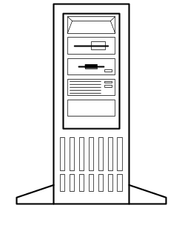

Firewalls: Protecting against break-ins and DoS
Passed Packet
Hardened
Client PC
Internet
Firewall
Packet
User
Internet
Attack
Packet
Dropped
Packet
Attacker
Hardened
Server
Internal
Corporate
Network
Log File
Firewalls could be hardware or software-based
Firewalls need configuration to implement access policies
Security audits need to be performed to fix mis-configuration

Slide 38
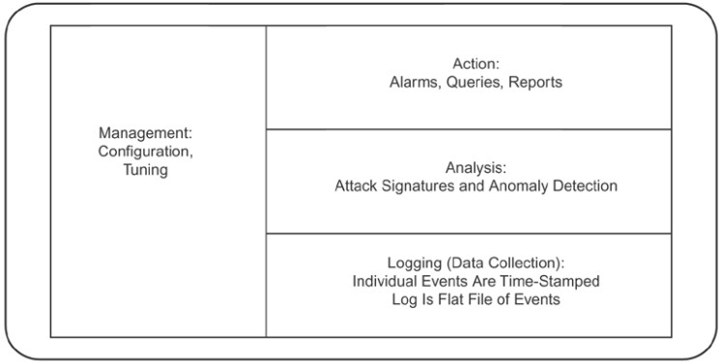
Intrusion Detection System (IDS): Protecting against break-ins and DoS
Software or hardware device that
  Capture network activity data in log files
  Analysis captured activities
  Generate alarms in case of suspicious activities
Intrusion Detection System

Slide 39
Intrusion Detection System (IDS): Protecting against break-ins and DoS
1.
Suspicious
Packet
4. Alarm
Intrusion
Detection
System
Network
Administrator
2. Suspicious
Packet Passed
Internet
Attacker
3. Log
Packet
Hardened
Server
Log File
Corporate Network

Slide 40
Other defense measures
Good Access Control policies
  Strong passwords
  Good access rights implementation for resources (computer, folders, printers, etc.)
  Good group policies
Installing patches for
  Operating systems
  Application software
Most
important

Slide 41
Summary Questions (Part 3)
What do ping messages allow? Why are ping scans often not effective?
What does social engineering mean?
What is meant by eavesdropping? Message alteration?
What kind of techniques could be used to protect against eavesdropping?
What is meant by DoS?
What kind of tools could be used to protect a system against DoS?

